Slide 1
Geothermal Energy

Slide 2
Introduction
Geothermal Energy is the thermal energy present in the interior of the earth.
Volcanoes, geysers and hot springs are visible signs of large amounts of heat lying in the earth interior.
Although the amount of thermal energy with in the earth is very large, but useful geothermal energy can be extracted at only certain suitable sites.

Slide 3
Contd…
It is the heat energy stored in the earth, generated by natural sources.
From the decay of radioactive nuclei that are embedded within the Earth.
From residual heat left over from Earths
formation.
The rest of the energy comes from meteorite impacts.

Slide 4
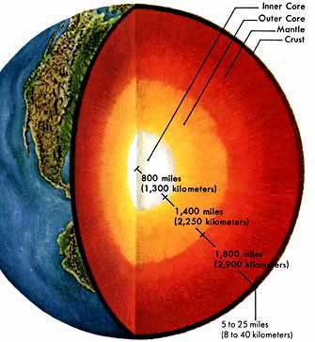
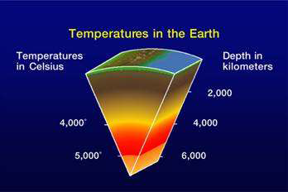

Slide 5
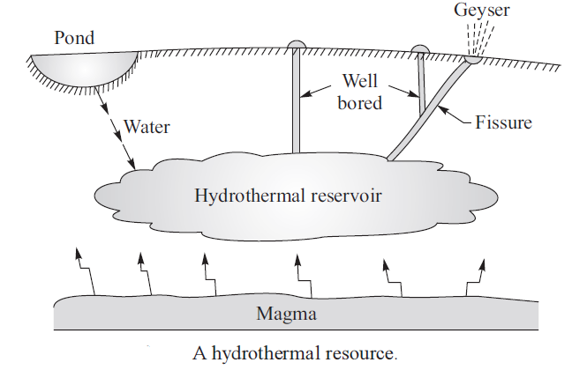
Geothermal Resource

Slide 6
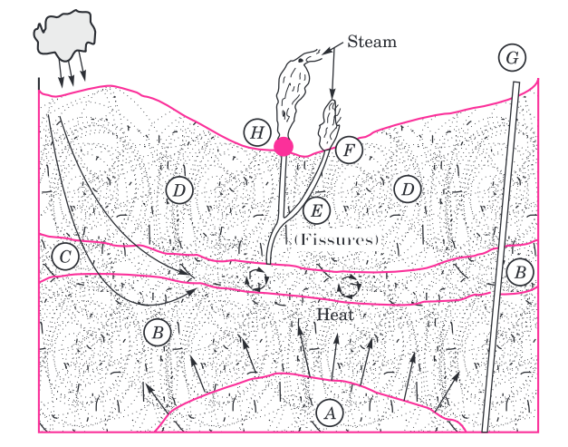
Typical Geothermal Field
A-Magma
B-Igneous Rock
C-Permeable Reservoir
D-Sold Rock
E-Fissure

Slide 7
Geothermal Resources
Hydrothermal-100 to 180^{O}C
Geo pressured -2400-9100m & 160^{O}C , 1000 bar
Hot dry rock-90-650^{O}C
Volcanic and -700-1600^{O}C
Magma (Molten Rock)

Slide 8
Geothermal Resources
Hydrothermal resources contain superheated water, steam or both in fractured or porous rock, but further trapped by a layer of impermeable rock. Hydrothermal resource may give dry and pure steam with temperature above 240°C. However, majority of these resources have moderate temperatures ranging from l00 to l80°C.
Geopressured resource is hot water or brine trapped underground at the depth of about 2400–9l00 m with temperature at about l60°C. The pressure of the water is about l000 bar. Although it has great heat potential for power generation but it is uneconomical due to low temperature and high cost of drilling into earth’s surface to such a great depth. In case brine has recoverable methane, brine water can be used with combustion of methane to generate electricity.
Hot dry rocks or Petro-thermal resources consist of high-temperature rocks ranging from 90 to 650°C. The rocks can be fractured and water may be circulated through the rocks to extract thermal energy.

Slide 9
Geothermal Resources
Geothermal energy in the form of active volcanic vents occur in many parts of the world. There is molten rock or magma present in these volcanic vents at temperature ranging from 700 to l600°C. Magma chambers have got huge thermal energy compared to other geothermal resources. However, extracting thermal energy from volcanic vents is difficult.
Molten rock or magma may be present at shallow depths at certain places. The heat can be easily extracted at these places.
There are certain regions where the heat of molten rock in the earth is pushed up through fault cracks near earth²s surface within 2–3 km, thereby creating hot spots. In case vents exist, hot water and steam are violently and periodically ejected from these vents. The water ejecting from a hot spring is heated by geothermal heat.
When water percolates deeply enough into earth’s crust, it is heated as it comes in contact with hot rocks. The water in hot springs in non-volcanic areas is heated in this manner. When water gets mixed with mud and clay, it is called a mud hole and it produces boiling mud pond.

Slide 10
Geothermal Resources
The high temperature near magma may cause water to boil and transform into superheated steam. When the steam ejects out through vents in earth’s crust in a jet, it is called a geyser or steam ejector.
When the water is ejected in the form of hot water, it is called hot springs.

Slide 11
Hydrothermal Resources
Hydrothermal resources are formed when underground water has access to high-temperature, porous rocks, capped by a layer of solid impervious rock. The entrapped water is heated by surrounding rocks.
The hydrothermal resources can be classified depending on the heating of entrapped water as dry steam fields or vapor dominated resources, wet steam fields or liquid dominated resource and hot water resource.
Vapor dominated fields can deliver steam with almost no water.
Liquid dominated fields can deliver the mixture of steam and hot water, while hot water resource can only deliver hot water.

Slide 12
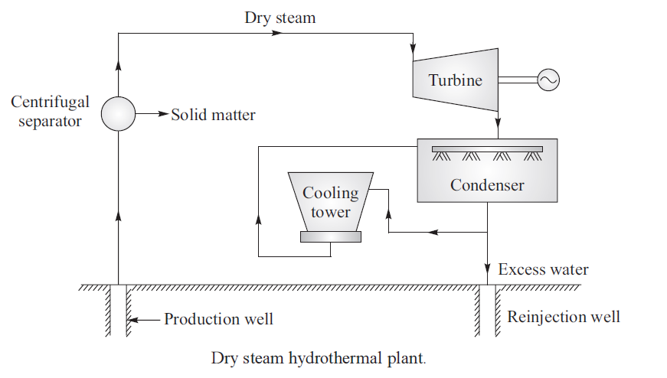
Vapor Dominated Plant

Slide 13
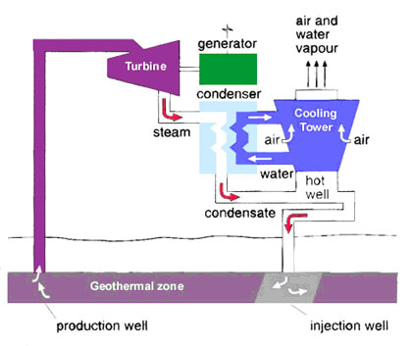
Vapor Dominated Plant

Slide 14
Vapor Dominated Plant
Water boils underground in a hydrothermal resource when it has pressure of about 7 atm and temperature of about l65°C. The dry steam fields are located at the Geysers region of California (USA), the Larderello (Italy) and the Matsukawa region of Japan. The plant consists of (i) production well to extract steam from the hydrothermal resource, (ii) a centrifuge separator to remove solid matter from the steam, (iii) a turbine to convert thermal energy into mechanical energy, (iv) a generator coupled to turbine to generate electric power, (v) a condenser to condense wet steam exited from turbine into water by direct contact with cooling water and (vi) a cooling tower to cool warm water exited from the condenser and returning the cooled water to the condenser.
The excess water is disposed of in the reinjection well as shown in Figure. The cycle used in this system is called Rankine cycle.

Slide 15
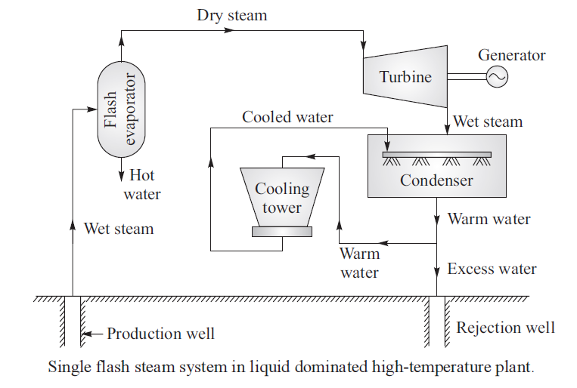
Wet Steam or Liquid Dominated

Slide 16
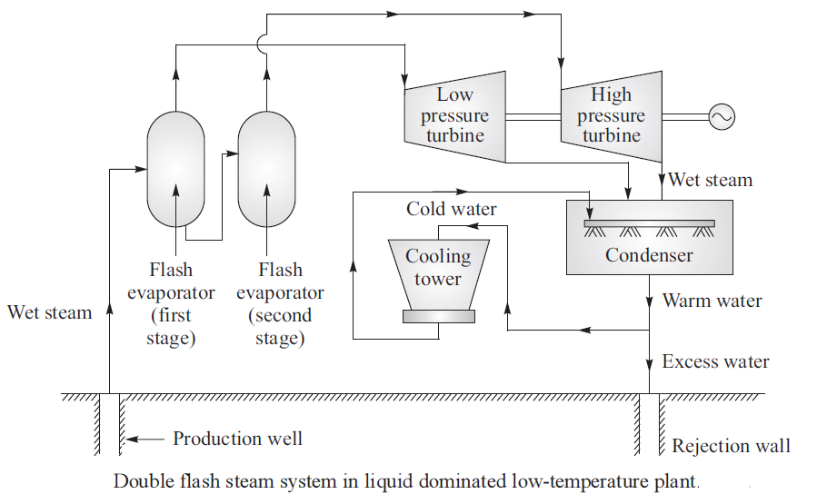
Double flash steam system in liquid dominated low temperature plant

Slide 17
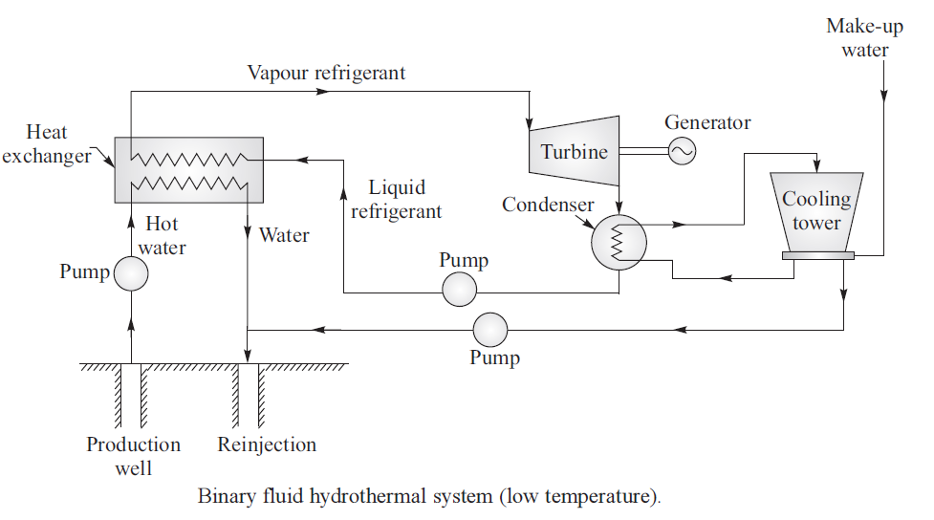
Binary Fluid Hydrothermal System

Slide 18
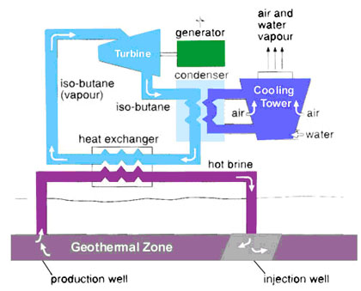
Binary Fluid Hydrothermal System

Slide 19
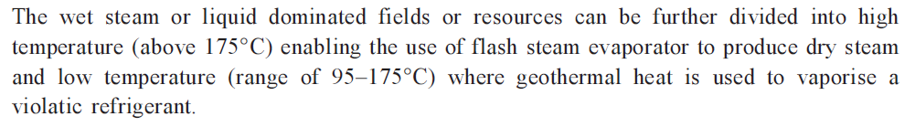
Wet Steam or Liquid Dominated
Liquid dominated high-temperature plant or system. The type of plant or system is used where hydrothermal reservoir has temperature and pressure of 230°C and 40 atm respectively. The plant consists of flash evaporator to obtain dry steam from high temperature wet steam by lowering pressure in it, turbine which directly coupled generator to extract energy from dry steam, condenser to condense used steam into water and cooling tower to cool the warm water. The excess water is disposed of in the ground as shown in Figure.
In dual flash system, the hot water is flashed in two flash evaporators in two stages. Steam obtained in the first stage is used in low pressure turbine and steam is again flashed to obtain high pressure to be used in high pressure turbine as shown in Figure. The 50 MW Hatchobane plant, Kyushu in Japan is a double flash system.

Slide 20
Wet Steam or Liquid Dominated
Liquid dominated low-temperature plant or system. The water available from the hydrothermal reservoir is at low temperature range of 90–l75°C, which is insufficient to produce steam using a flash evaporator. A low boiling point refrigerant is used as a working medium. The plant runs on binary cycle. The refrigerant is evaporated in a heat exchanger using the heat of water obtained from hydrothermal reservoir. The refrigerant vapour runs the turbine with a generator coupled to it. The used refrigerant vapour is condensed in a condenser. The cooled water for cooling in condenser is obtained from a cooling tower. The binary cycle system is shown in Figure. Kamchatka binary cycle plant in Russia is a 680 kW capacity plant using hot hydrothermal water at 80°C. The working fluid is Freon-l2.

Slide 21
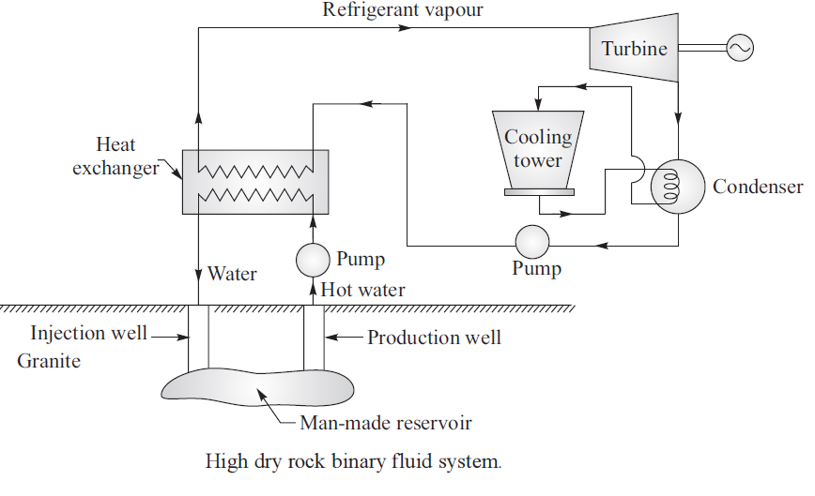
Hot Dry rock resource

Slide 22
Hot Dry rock resource
Hot dry rocks (HDR) resources or dry geothermal fields are much more common than hydrothermal reservoirs. The working of high dry rock binary fluid system is shown in Figure. These HDR resources are more accessible compared to hydrothermal resources. The underground hot dry rocks due to geothermal heating have temperatures exceeding 200°C and there is no water in their vicinity. Water as heat transfer fluid has to be injected into a man-made reservoir in the hot dry rocks field. After drilling and fracturing of the field, a man-made reservoir is created.

Slide 23
Interconnection of Geothermal Fossil Systems (Hybrid Systems)
The concept of hybrid geothermal fossil fuel systems utilizes the relatively low temperature heat of geothermal sources in the low temperature end of a conventional cycle and the high temperature heat from fossil-fuel combustion in the high temperature end of that cycle. The concept thus combines the high efficiency of high temperature cycle with a natural source for part of the heat addition, thus reducing the consumption of expensive and non-renewable fossil fuel.
There are two arrangements
i) Geothermal Preheat ii) Fossil Superheat
Geothermal Preheat is suitable for Low temperature liquid dominated systems whereas Fossil Superheat system is suitable for vapor dominated and high temperature liquid dominated systems

Slide 24
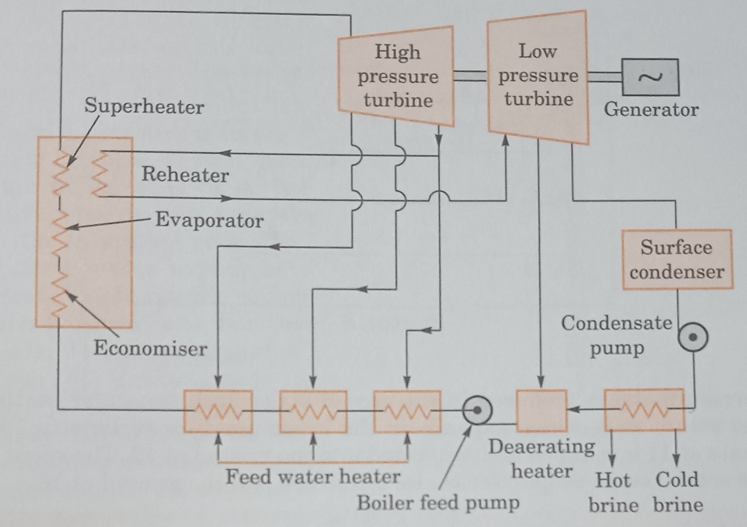
Geothermal Preheat Hybrid System

Slide 25
Geothermal Preheat Hybrid System
In these systems, the feed water of conventional fossil fueled steam plant is heated by low temperature geothermal energy. Geothermal heat replaces some or all of the feed water heaters, depending upon its temperature. A cycle operating on this principle is illustrated schematically. In it, geothermal heat heats the feed water throughout the low temperature end prior to an open type deaerating heater. It is followed by a boiler feed pump and three closed type feed water heaters with drains cascaded, backward. These receive heat from steam bled from higher pressure stages of the turbine. No steam is bled from the lower pressure stages because geothermal brine fulfills this function

Slide 26
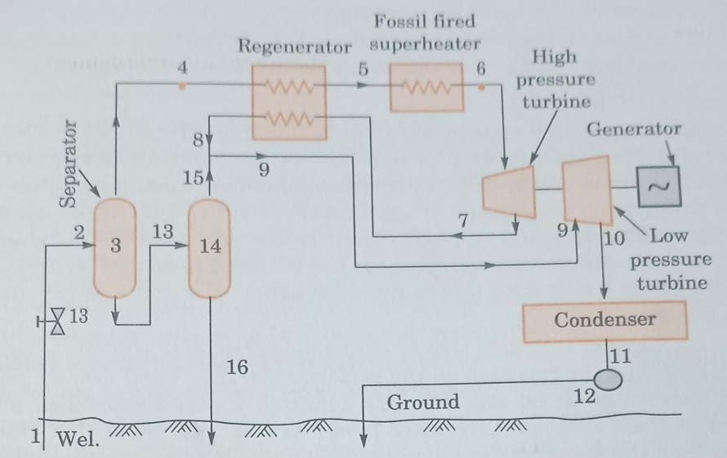
Fossil Superheat Hybrid System with two stage flash separator

Slide 27
Fossil Superheat Hybrid System with two stage flash separator
In these systems, the vapor dominated steam or the vapor obtained from a flash separator in a high temperature liquid dominated system is superheated in a fossil fired super heater. Based on this principle, a cycle is illustrated as shown inn figure. The system consists of a double flash geothermal steam system. Steam produced at 4 in the first stage flash separator is preheated from 4 to 5 in regenerator by exhaust steam from the high pressure turbine at 7. It is then superheated by a fossil fuel fired super heater to 6, and expands in the high pressure turbine to 7 at a pressure near that of second stage steam separator. It then enters the regenerator, leaves it at 8, where it mixes with the low pressure steam produced in the second stage flash separator at 15, and produces steam at 9, which expands in the low pressure turbine to 10. The condensate at 11 is pumped and reinjected into the ground at 12. The spent brine from the second stage evaporator is also reinjected into the ground at 16

Slide 28
Applications
Space Heating
Air-conditioning
Drying
Green Houses
Aquaculture
Hot Water
Generation of Electric power.
Industrial process heat.

Slide 29
Advantages
(i) It is a reliable source of energy.
(ii) It is in continuous supply.
(iii) Its availability is independent of weather.
(iv) It has an inherent storage capability and it does not require any storage device.
(v) Small space is required to install the plant.
(vi) It does not require any supply of fuel to generate heat.
(vii) It is the least polluting.
(viii) It is versatile in use.
(ix) It is cheaper than other energy sources.

Slide 30
Disadvantages
(i) Geothermal energy is available as low-grade heat, that is, temperature of geothermal fluid is low.
(ii) Geothermal fluids also bring dissolved gases and solute, which lead to air and land pollution.
(iii) Removal of heated water from the hydrothermal reservoir may lead to land subsidence or seismic imbalance.
(iv) Drilling and blasting of wells may cause instability of land structure and may develop risk of any earthquake or seismic imbalance.
(v) Geothermal energy cannot be transported over long distances (less than 30 km).
(vi) The life of plant equipment is limited due to corrosive and abrasive nature of geothermal fluids.

Slide 31
Thank you

Slide 32
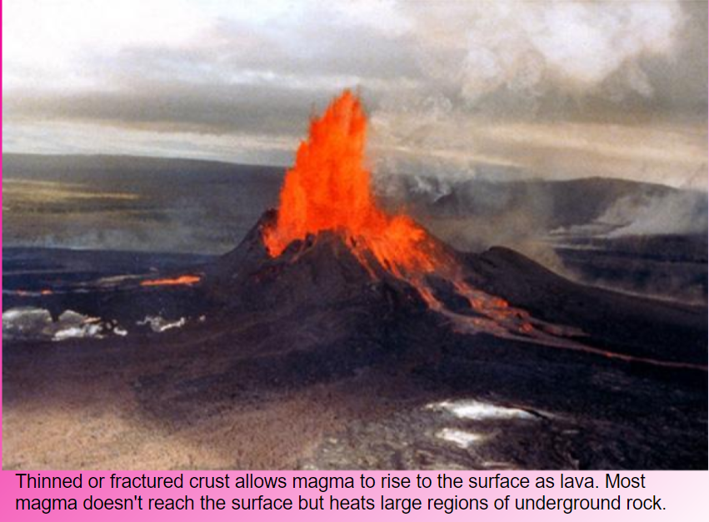

Slide 33
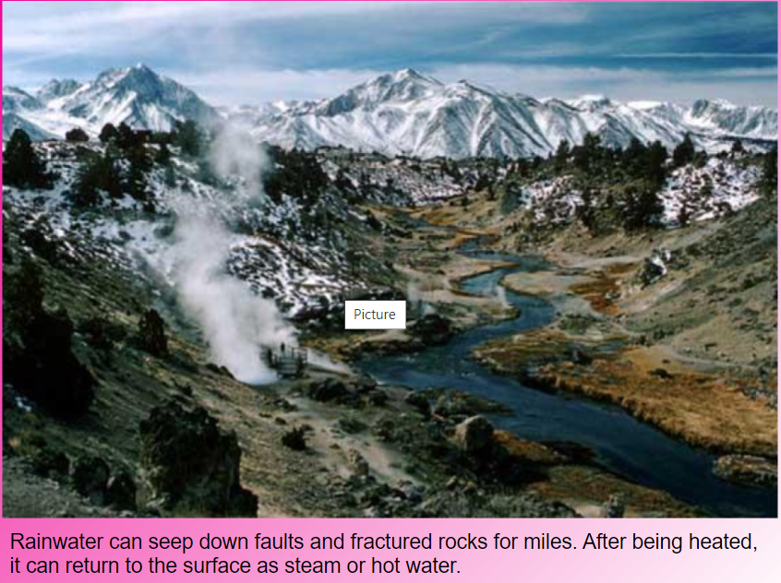

Slide 34
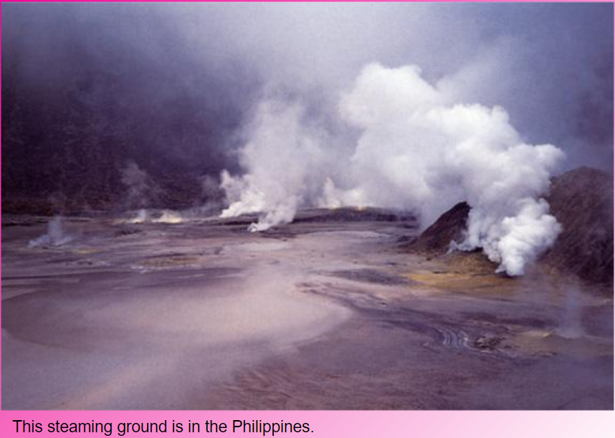

Slide 35
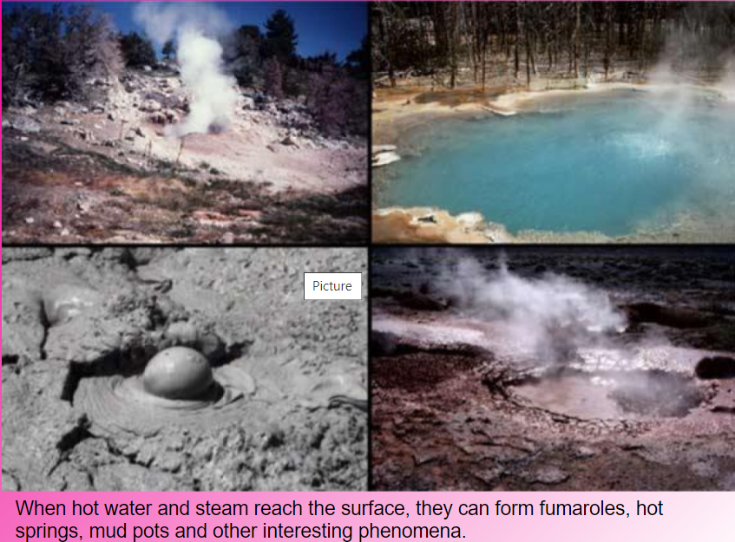

Slide 36
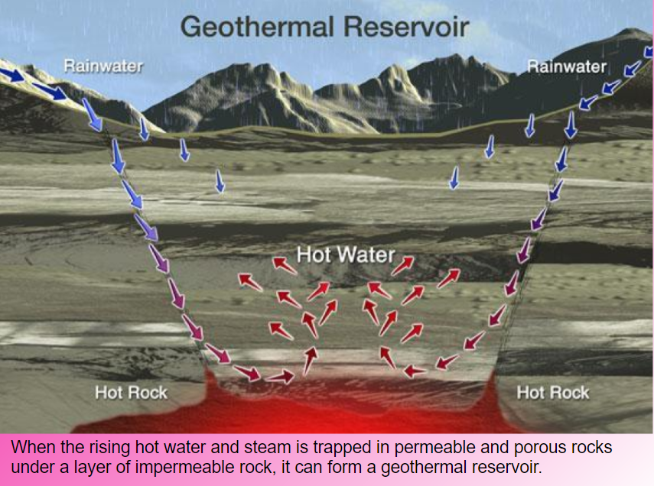

Slide 37
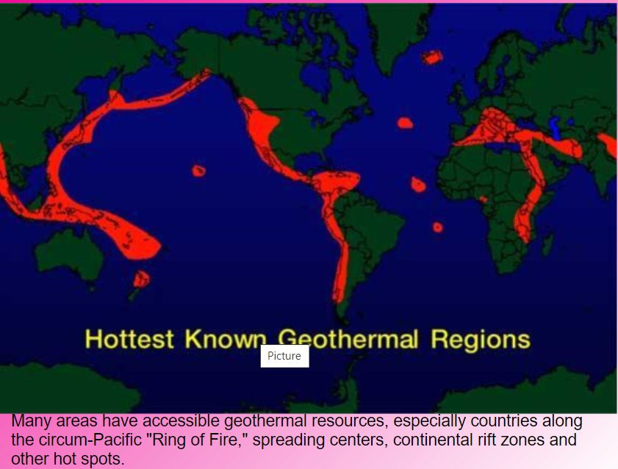

Slide 38
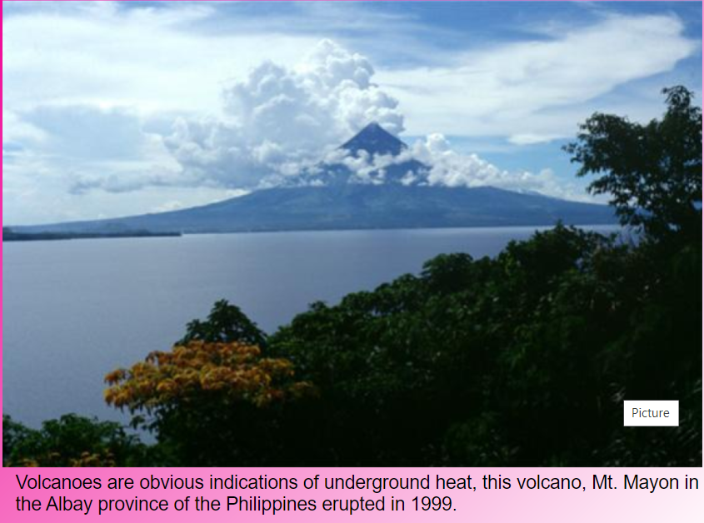

Slide 39
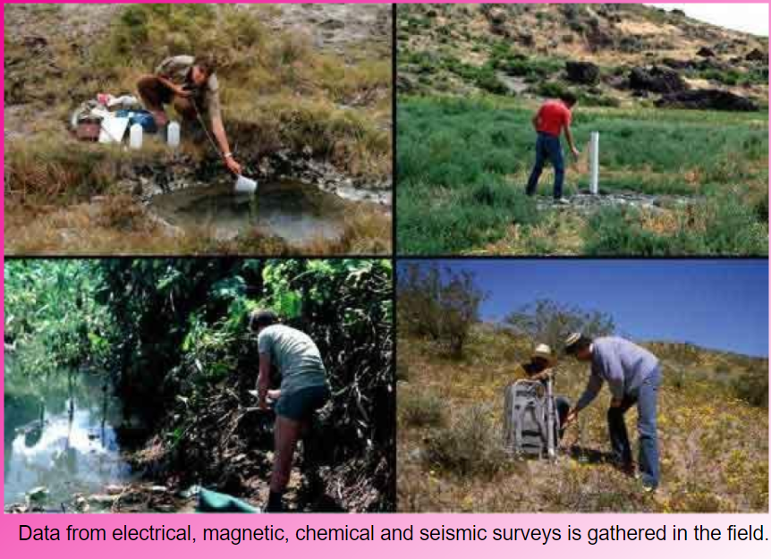

Slide 40
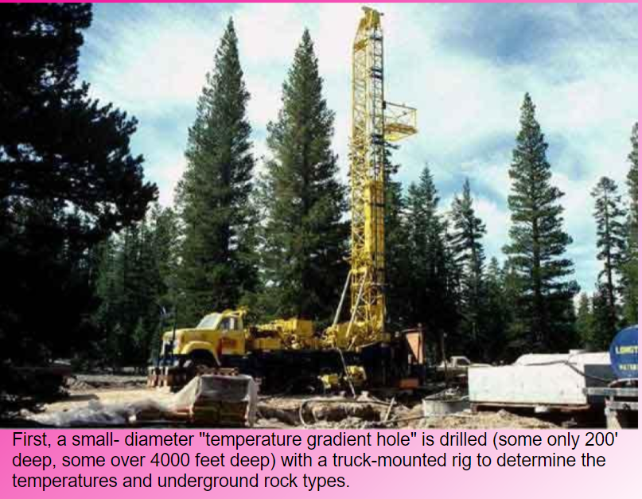

Slide 41
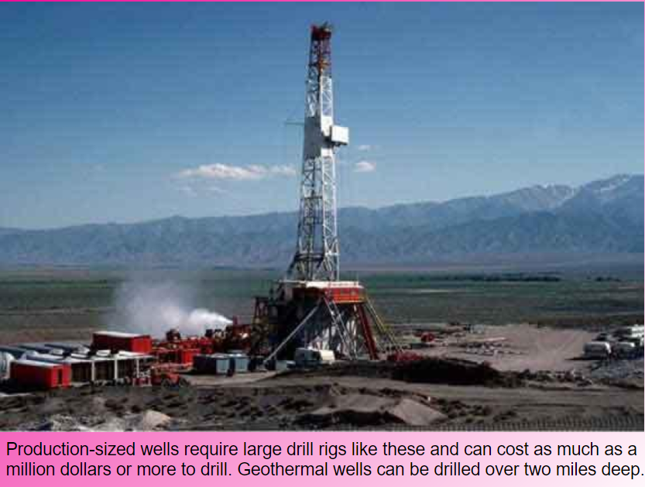

Slide 42
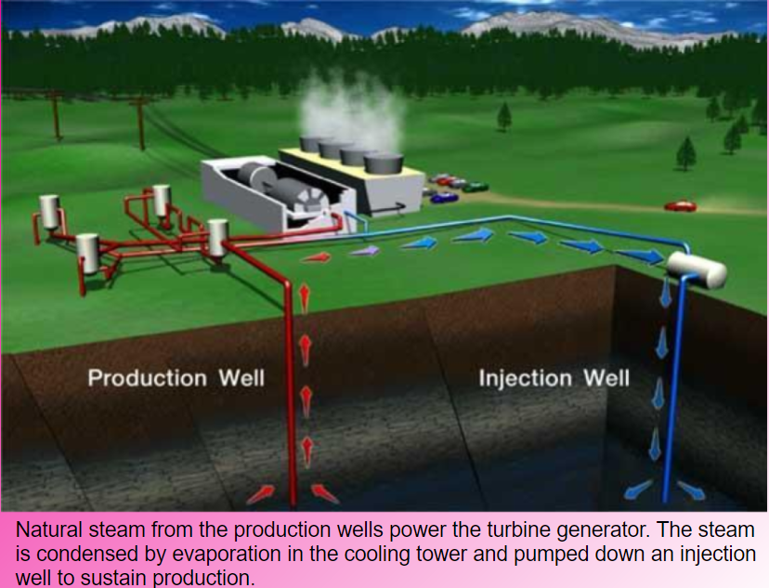

Slide 43
